Slide 1


CAPSTONE PROJECT
Impact of US-Iran Conflict on Global Oil Prices and Petrol Prices Using Power BI
Presented By
Student Name: Abhijay Dileep Menon
College Name: SRM University
Department: Mechanical Engineering
Email ID: abhijaymenon006@gmail.com

Slide 2
OUTLINE:
Problem Statement (Should not include solution)
Proposed System/Solution
System Development Approach (Technology Used)
Algorithm & Deployment
Result (Output Image)
Conclusion
Future Scope
References

Slide 3
Problem Statement:
Global geopolitical conflicts significantly impact energy markets. The US-Iran conflict has created uncertainty in global oil supply, leading to fluctuations in crude oil prices and increases in petrol prices across multiple countries.
These price changes affect:
• Transportation costs • Inflation rates • Economic stability of oil-dependent countries
Therefore, there is a need for analyzing the relationship between war events, oil price volatility, and petrol price increases. Using an interactive data analytics system analyze geopolitical events and visualize their impact on global energy prices.

Slide 4
Proposed Solution:
The proposed system uses Power BI data analytics to analyze the impact of geopolitical conflicts on global oil and petrol prices. The solution will consist of the following components:
Data Collection: Data was collected from multiple datasets including:
• Global crude oil daily price data • Petrol price comparisons across countries • War timeline events • Country economic impact indicators
Data Preprocessing: The datasets were cleaned and transformed using Power BI Power Query Editor.
• Removing null values • Changing data types • Standardizing country and region names • Creating calculated columns such as price increase percentage
Data Analysis: The cleaned datasets were connected through table relationships in Power BI to analyze:
• War events vs oil price spikes • Oil prices vs petrol price increases • Petrol price increases vs economic vulnerability
Visualization: Interactive dashboards were created to present insights using:
• Line charts • Bar charts • Maps • KPI cards • Tables
These visualizations allow users to explore global energy market changes caused by geopolitical conflicts.

Slide 5
System Approach:
Software Required:
• Power BI Desktop • Microsoft Excel / CSV datasets • Windows operating system
Libraries / Tools Used
• Power Query Editor (Data Cleaning) • Data Modelling (Table Relationships) • DAX (Data Analysis Expressions) • Interactive Visualizations • Dashboard Filtering and Slicers

Slide 6
Algorithm & Deployment:
Data Analysis Algorithm:
The project uses data analytics techniques.
1. Data Input
• Crude oil daily price dataset • Petrol price comparison dataset • War event timeline dataset • Country economic impact dataset
2. Data Modeling
Relationships were created between datasets to build a structured data model:
War Events → Oil Price Changes → Petrol Price Impact → Economic Impact
3. DAX Calculations
Important measures were created using DAX such as:
• Average oil price • Petrol price increase percentage • Oil market volatility • Total war events
4. Dashboard Deployment
The dashboards were created in Power BI Desktop.

Slide 7
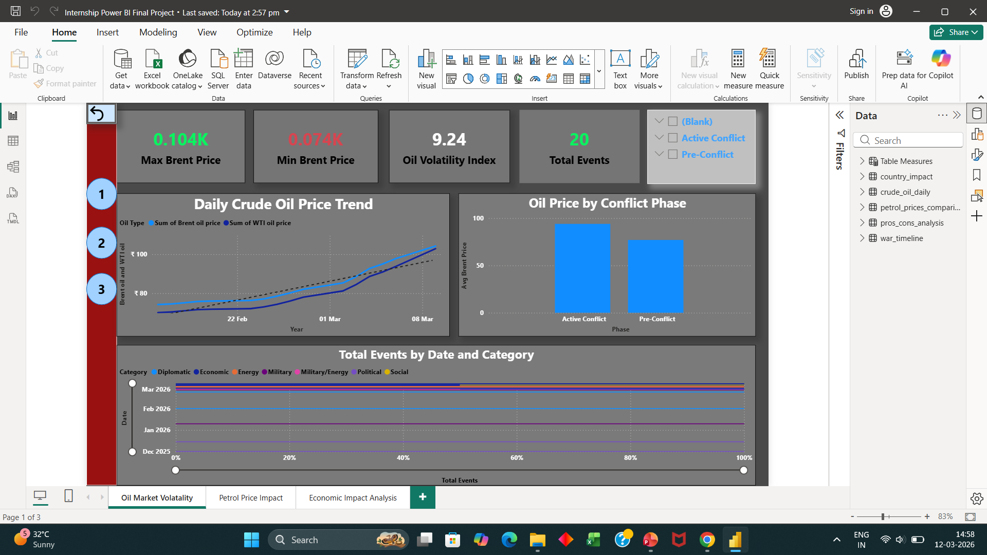
Result:

Slide 8
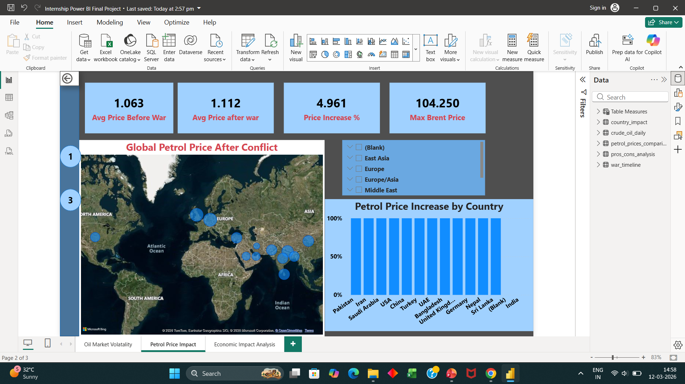
Result :

Slide 9
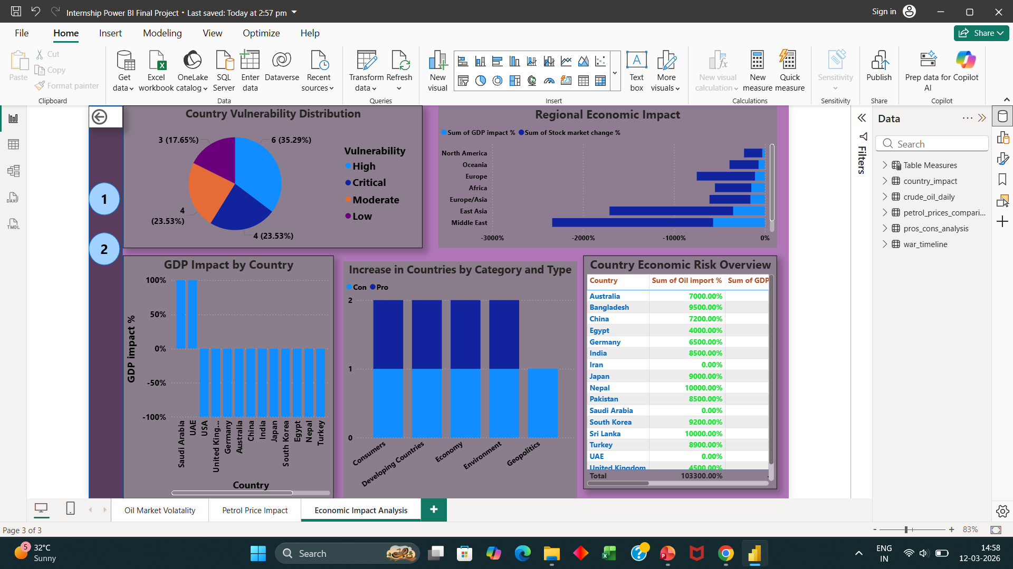
Result :

Slide 10
Conclusion:
The project successfully demonstrates how geopolitical conflicts influence global energy markets.
Key findings include:
• Oil prices increased significantly during periods of conflict escalation. • Countries highly dependent on oil imports experienced the largest petrol price increases. • Economic indicators such as inflation risk and GDP impact were strongly correlated with oil price fluctuations.
Power BI dashboards provide a powerful way to visualize complex geopolitical and economic relationships.

Slide 11
Future scope:
• Integrating real-time oil price APIs • Expanding analysis to include additional conflicts and geopolitical events • Applying machine learning models to predict future oil price trends • Including additional economic indicators such as inflation and transportation costs • Deploying dashboards online using Power BI Service

Slide 12
References:
Dataset : Kaggle.com
International energy market reports
GitHub Link: https://github.com/Abhijay4518/US-Iran-Oil-Price-Impact-PowerBI.git
Linkedin Link : https://www.linkedin.com/in/abhijay-menon-922226324/

Slide 13
Thank You

